Slide 1
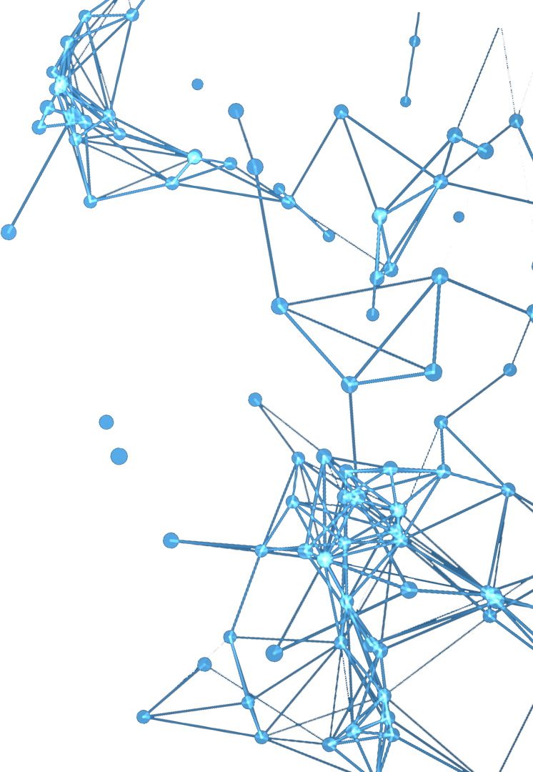
Work on AlphaFold2 and RoseTTAFold
Report Person: Zhu Junyong
Date：2021.7.27

Slide 2
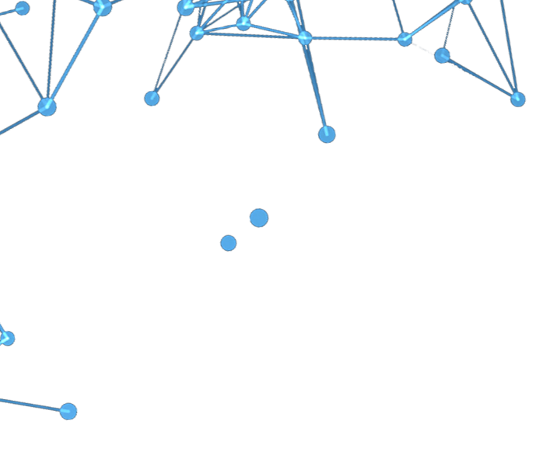
01
Highlights on AlphaFold2
Attention in Evoformer：
MSA row/column-wise self-attention
Triangular update and self-attention
MSA representation update Pair representation
(3-track Network achieves the mutual update of 1D，2D and 3D information in RoseTTAFold )
IPA→ 3D-Equivariant in Structure Module
(SE(3)-Transformer also achieves 3D-Equivariant in RoseTTAFold )
end-to-end + Recycling

Slide 3
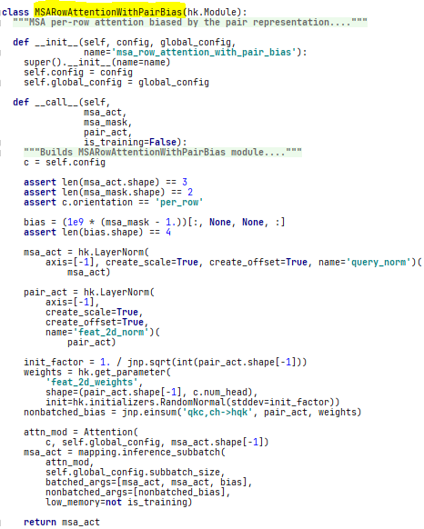
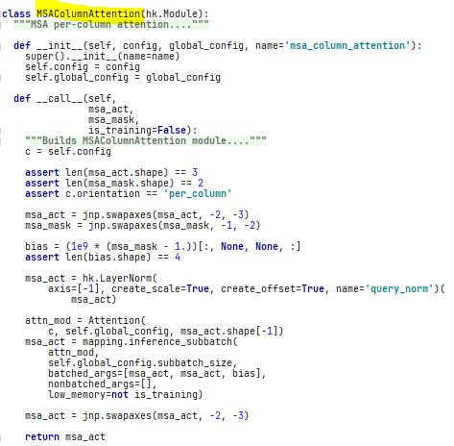
02
Main Code(Attention in Evorformer)

Slide 4
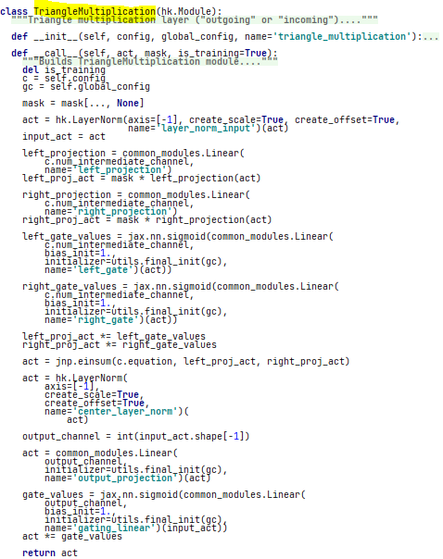
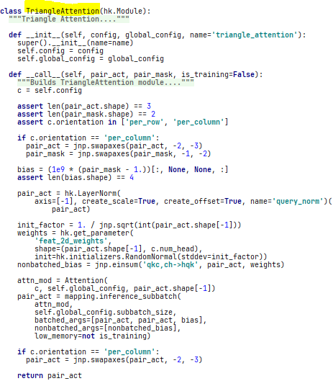
02
Main Code(Attention in Evorformer)

Slide 5
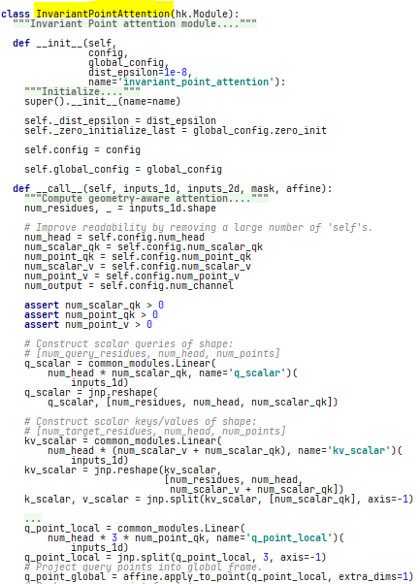
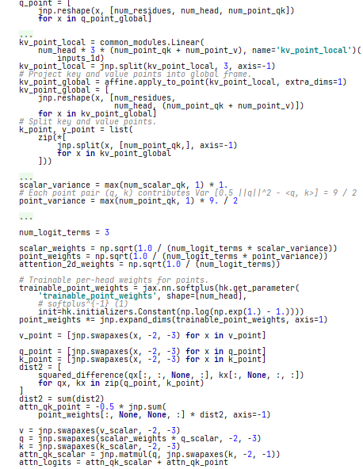
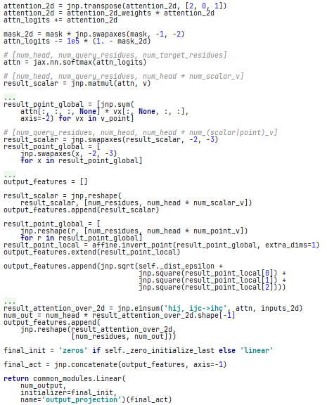
02
Main Code(IPA)

Slide 6
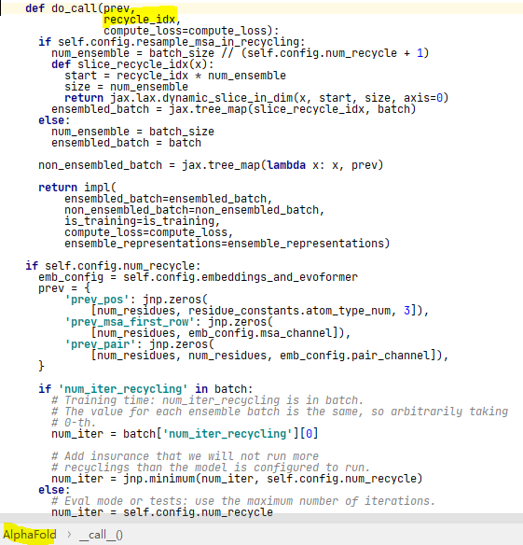
02
Main Code(recycling)

Slide 7
03
Highlights on RoseTTAFold
3-track Network
information flows between 1D sequence information, 2D distance map, and the 3D coordinates.

Slide 8
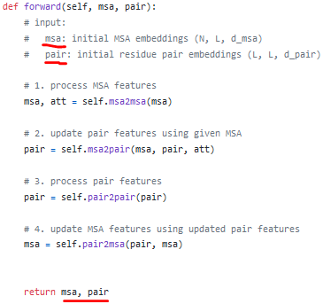
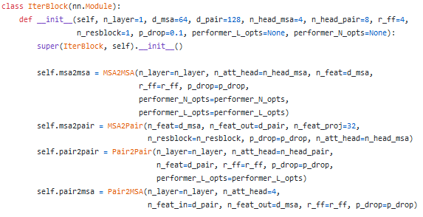
04
Main code

Slide 9
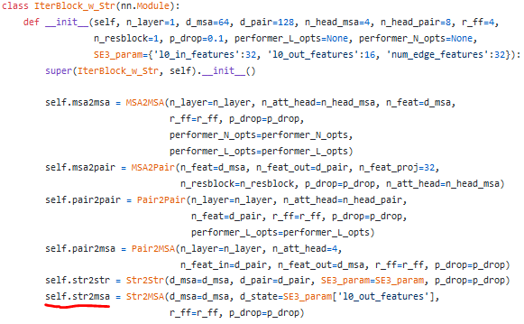
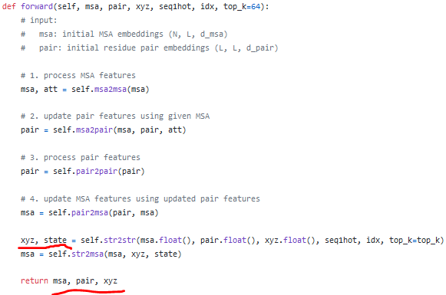
04
Main code

Slide 10
05
Possible directions(categories)
Protein structure prediction
QA
Protein contact/distance prediction
Protein-Protein interactions prediction
Protein complex prediction
Protein refinement

Slide 11
06
Conclusion
What I want to use most：
AlphaFold2：
Evoformer ( several attention mechanisms,1D and 2D information update mutually)
Recycling(a good idea to improve network performance)
RoseTTAFold:
3-track Network （ attention module code of RoseTTAFold ）
information flows between 1D sequence information, 2D distance map, and the 3D coordinates
Ideas：
More input features
Evoformer/3-track Network → QA/···（New）
New transformer-based architecture (partial utilization of Alphafold2’s and RoseTTAFold’s methods)

Slide 12
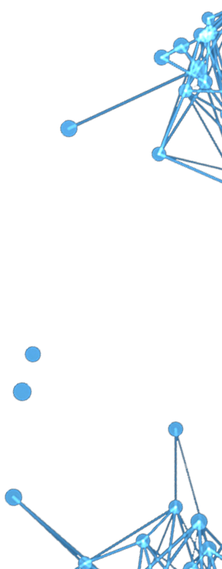
THANKS

